Slide 1
Counting Cards
By Connor Smith

Slide 2
BlackJack
You vs the dealer
You can hit or stand
Card total over 21 you bust
Card total is less then the dealer you lose

Slide 3


The count
Best odds 49%
Edward Thorp wrote “Beat the Dealer” published in 1962
2-6: count +=1
7-9: no change
1 or 10: count -=1
The higher the count the greater the chance of a high card being dealt
The higher the count the more you bet

Slide 4
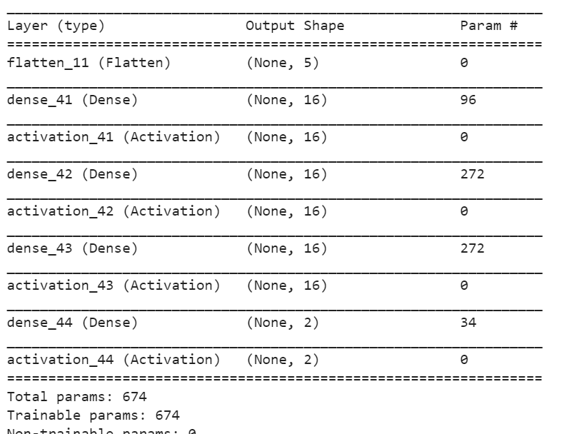
Reinforcement learning
DQN agent
Given an action and observation space
Trying to maximize a reward
Reward set to 1.0
Lambda callback to track rewards

Slide 5
Observation space
Regular notebook
Sum hand
Dealers face card
Useable ace
Counting cards notebook
Sum hand
Dealers face card
Useable ace
The count
Length of the deck

Slide 6
Limited deck
The count is updated as cards are dealt
If the deck is empty it is returned to a 52 card deck and the count is set back to 0
Target model update

Slide 7
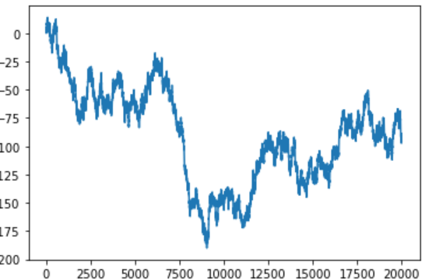
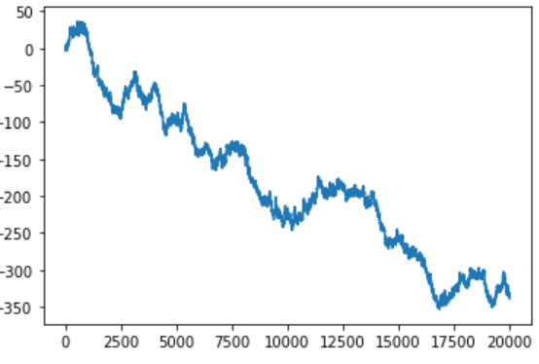
Results
If we treat the reward like betting a single dollar every game:
20,000 games
BlackJack:
-95
Regular:
- 339

Slide 8
Modern day game play
Casinos play with multiple deck
Count can still be kept
Running count = true count / number of decks left

Slide 9
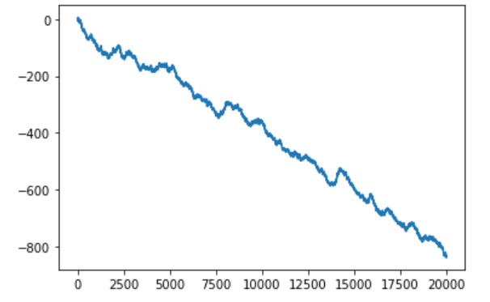
New model
6 decks
Running count
-836

